Slide 1
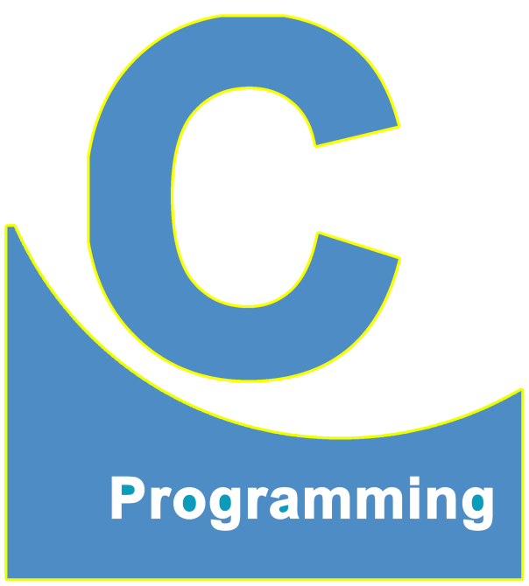
01
02
C Language
Lecture 1
04

Slide 2


Today’s Agenda
01
What is Programming Language ?
02
History of C Language
03
Types of Software
04
Steps Required For Developing A Program

Slide 3
What is Programming Language ?
What is Programming Language ?
Programming Language are like translator.
Why we should learn any programming language ?
We require them because , it is very difficult for humans to speak in terms 0s and 1s
and it will be impossible for computer to speak Hindi or English.
Thus in order to communicate with a machine it is important there should be some
mechanism which can translate human language to machine language and vice versa.
This translation is done by programming language.

Slide 4

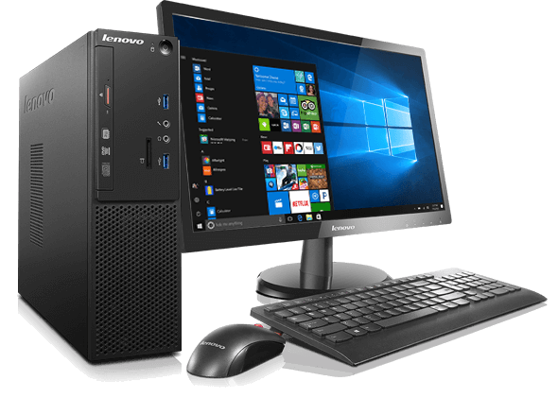
What is Programming Language ?
Programming
Language

Slide 5
What is Programming Language ?
Do you know how many languages are there in the world ?
More than 900 languages in the world.
If there are so many languages then why we are starting our
programming Journey with C language.
'C' is a base language for many programming languages. So, learning 'C' as the main language will play an important role while studying other programming
languages. It shares the same concepts such as data types, operators, control statements and many more.

Slide 6
History of C Language
Who Created C language ?
1. Dennis Ritchie (Father Of C)
2. Brian Kernighan
Where C language was Developed ?
AT&T ( American Telephone and Telegraph) in Bell Labs USA.
When was C Developed ?
In 1972

Slide 7
History of C Language
Why C language Called C ?
The base or father of programming languages is 'ALGOL.' It was first
introduced in 1960. 'ALGOL' was used on a large basis in European countries.
'ALGOL' introduced the concept of structured programming to the developer community. In 1967, a new computer programming language was announced called as 'BCPL' which stands for Basic Combined Programming Language.
Just after three years, in 1970 a new programming language called 'B' was
introduced by Ken Thompson that contained multiple features of 'BCPL.' This programming language was created using UNIX operating system at AT&T and Bell Laboratories. Both the 'BCPL' and 'B' were system programming
languages.

Slide 8
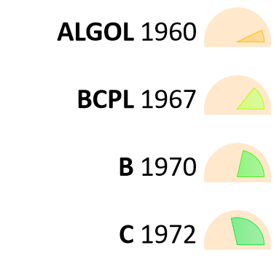
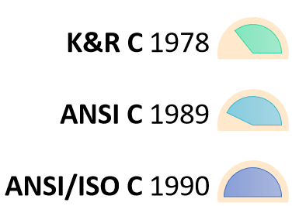
History of C Language
'C' programming language contains all the features of these languages and
many more additional concepts that make it unique from other languages.

Slide 9
Types Of Software
Why is C so popular even after 48 years have passed ?
Computer
Hardware
Software
These are devices attached to the
computer like keyboard, monitor,
RAM, HDD etc.
These are instructions on which a particular device operates

Slide 10
Types Of Software
Types Of Software
System Software
Application Software
Important for controlling the overall functioning of the machine like OS.
Important for a particular task like
WhatsApp us used for chatting,
Truecaller is used for getting called info, PUBG is used for playing online
game

Slide 11
Types Of Software
Languages Used For Developing These Software's
System Software
Application Software
The most popular and only option
Available in early 1960s was
ASSEMBLY LANGUAGE
Language like Pascal, Cobol, Fortran were user for developing application software like mathematical software, calculators etc

Slide 12
Types Of Software
What is the strength of C ?
When C language came in the market, it became the most versatile
language for developing both system software and application software
Thus we can say that is an ALLROUNDER language
System Software Developed In C
Application Software Developed In C
Unix
Linux
Mac OSX
Android
Almost every popular programming language is designed in C like:
Java, Python, PHP

Slide 13
Steps Required For Developing A Program
Writing the “SOURCE CODE”
Compilation Of The Source Code
Execution Of The Machine Code
What is IDE and what it dose ?
IDE stands for:
ITEGRATED : Together, all thing present in the same software
DEVELOPMENT : Programming
ENVIRONMENT : Software, Tool
This means that using an IDE we can write, compile as well as run a program

Slide 14
Steps Required For Developing A Program
Popular IDE of C
Source Code
IDE Company
Turbo C Borland
Code Blocks Various
Dev C++ Bloodshed
VS Code Microsoft
X-Code Apple
Compiler
Machine Code
CPU

Slide 15
Steps Required For Developing A Program
Translators
Compiler C, C++
2. Interpreter PHP
3. Assembler Assembly Language

Slide 16
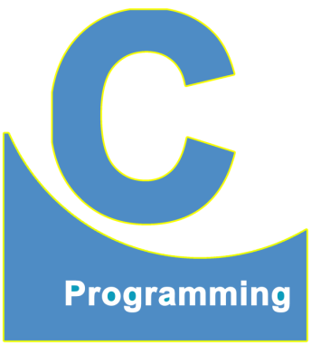
End of Lecture 1
For any queries mail us @: scalive4u@gmail.com
Call us @ : 0755-4271659, 7879165533
Thank you

